Slide 1

VISITOR MANAGEMENT SYSTEM
Presented by :-
SIA02 OMKAR AHER
SIA14 MAHADEV BHOSALE
SIA16 CHINMAY BODDAWAR
SIA19 MOHAK BOROLE

Slide 2
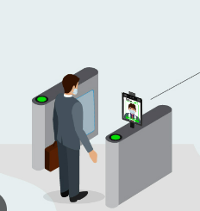
INTRODUCTION
The Visitor Management System with Face Detection and WhatsApp Integration is a project aimed at enhancing the security and efficiency of visitor management processes. This system utilizes facial recognition technology to detect and identify visitors, allowing administrators to efficiently approve or request visitors to wait via WhatsApp messaging.
The primary objective of this project is to streamline the visitor management process by automating visitor identification and communication with the help of advanced technologies.

Slide 3


WAITING

Slide 4
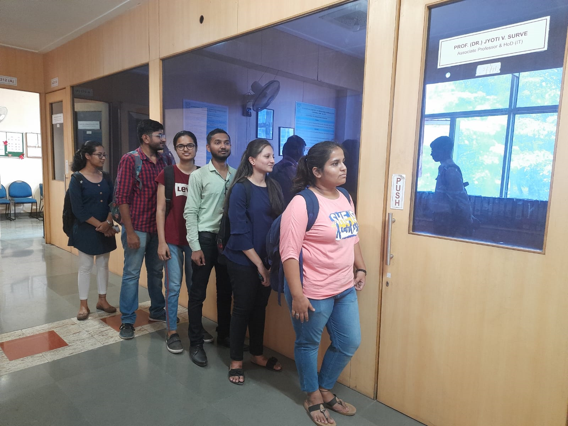
PROBLEM
High waiting time and waste of time in case admin is unavailable.
Long visitor queue.
No proper resource management.
Exhausting task.

Slide 5

SOLUTION
Speedy process due to face recognition.
Use of WhatsApp for multiplatform alert and managing visitor.
Time is saved with efficient management.

Slide 6




IMPLEMENTATION
Face Recognition
Notification
WhatsApp Message
Meeting

Slide 7
STEPS
Web cam can recognize visitor’s face.
If admin available
notification goes to admin screen.
The data of visitor open on admin screen.
According to his/her status he/she can allow or disallow or keep on waiting to visitor through WhatsApp Message.
If admin allow to visitor to visit then meeting will happen.
If admin not available that will notify to visitor through WhatsApp Message.

Slide 8
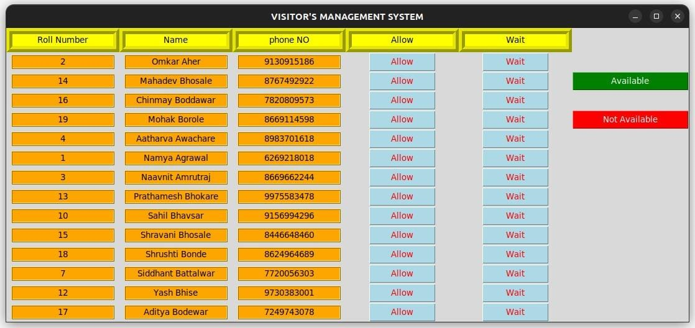

Slide 9
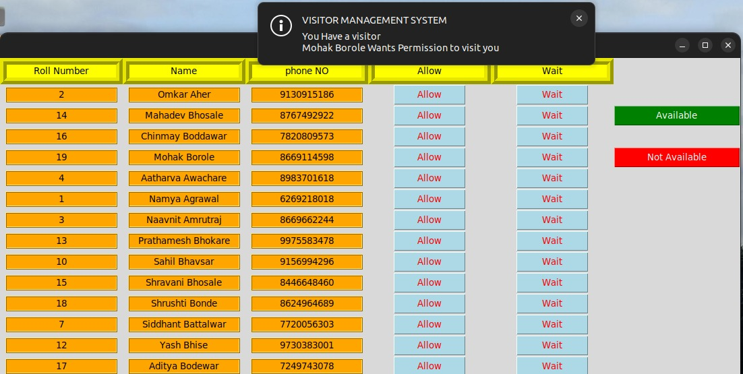

Slide 10
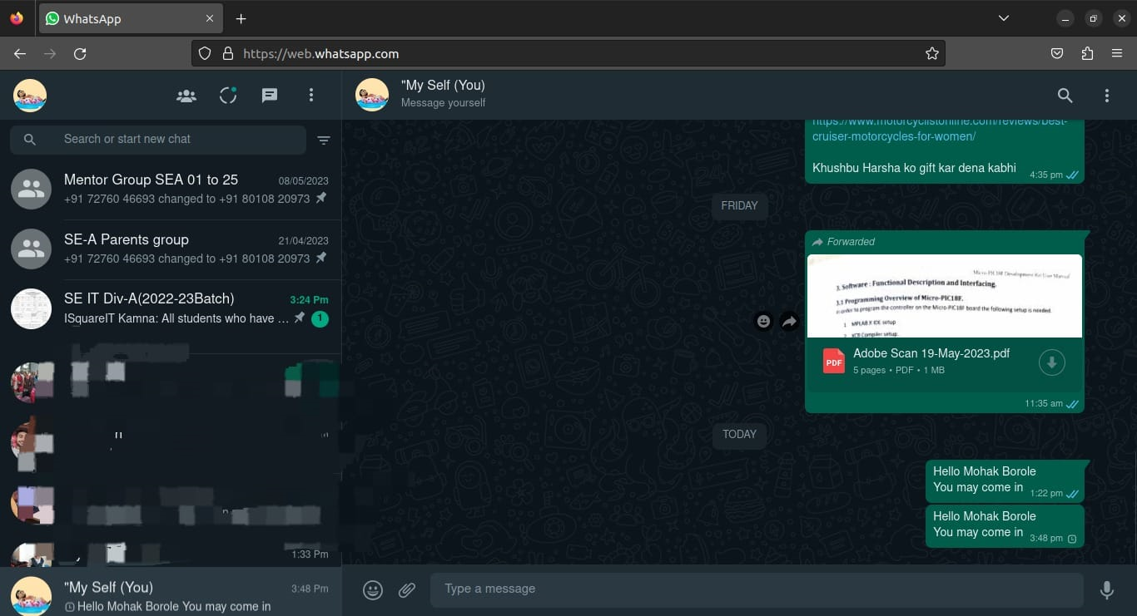

Slide 11
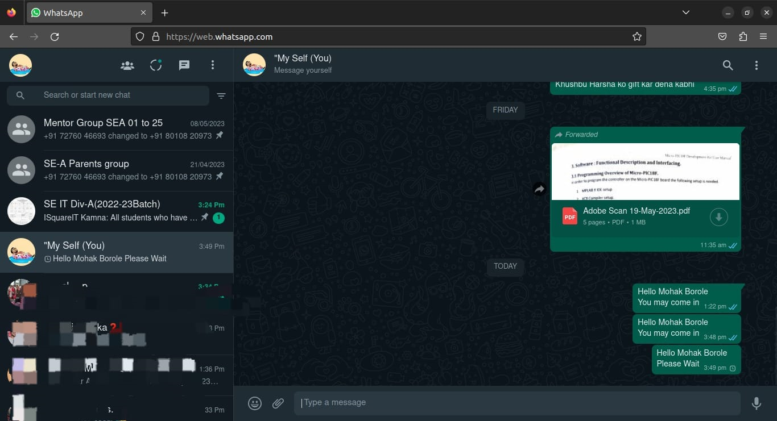

Slide 12
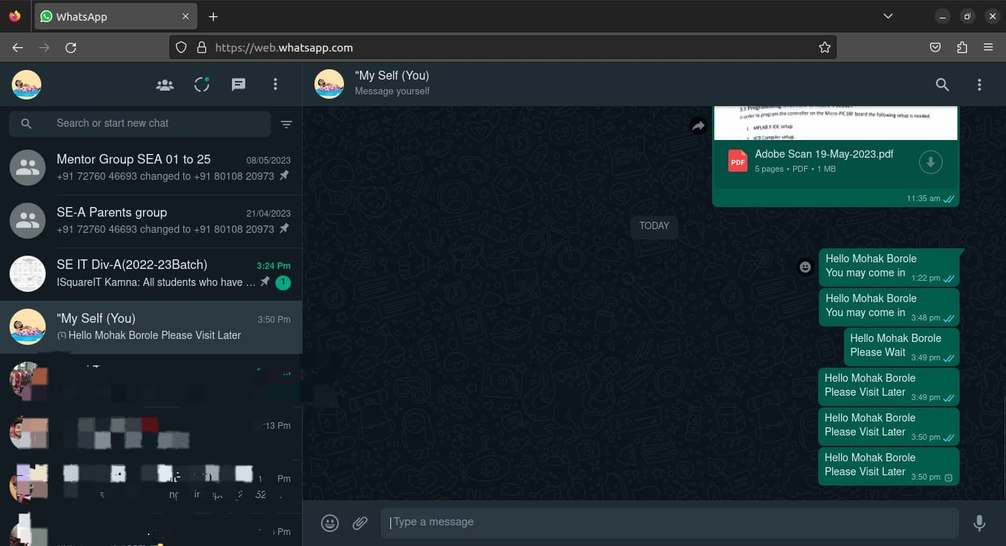

Slide 13


CONCLUSION
VMS is best way to handle visitor according to availability of admin.
Use of face recognition to reduce time consumption.
VMS is best way to handle visior according to availability of admin.
WhatsApp message alerts for multi-platform reach
At the end visitor’s data is saved.

Slide 14

THANK YOU

